Slide 1
Design Document - Group036
Group Member :
Jialun Chen, Wise Chua, Xinyuan Wang, Yao Zhou,
York Chen, Yuezheuxan Zhu, Ziqian Gao

Slide 2
Group Members’ Contributions for Phase 2
Jialun Chen - Check Log In and write test for UseCase and LogIn. made minor debug for Controller and UseCase.
Wise Chua - Complete GUI for whole game, transform from Command Line UI to GUI. Implement all GUI Frame. Added Testcase for usecase and entity.
Xinyuan Wang - Revise the structure to follow SOLID and Clean Architecture. Last check SOLID and Clean Architecture. UML diagram.
Yao Zhou - Part of GUI design for the game part.Add docstring to most classes.
York Chen - Complete GUI for login system, writing docstring for controller, entity and login system. Writing test for entity and controller.
Yuezhexuan Zhu - restructured the project, Implemented login-gamerun Interaction, added some GUI features, and write useCase tests
Ziqian Gao - wrote progress report.md for phase 2, modified BGM and UI fucntion for UI class, made minor debugs for USeCase class structure, marginally contributed in writting UseCase test

Slide 3
Significant Contributions
Jialun Chen - https://github.com/CSC207-UofT/course-project-bugwatcher_group036/pull/37/files
Login system code login construction
Wise Chua - https://github.com/CSC207-UofT/course-project-bugwatcher_group036/pull/63
Transform whole Command UI to GUI. Ensure GUI follow MVC/MVP and clean architecture.
Implement testcase after transforming to GUI and clean all IntelliJ warnings
Xinyuan Wang - https://github.com/CSC207-UofT/course-project-bugwatcher_group036/pull/57
Revise the re-construction of the project to follow clean architecture and SOLID.
Yao Zhou - https://github.com/CSC207-UofT/course-project-bugwatcher_group036/pull/97
Add docstring(earliest version of GUI was designed by me but revised and pulled by someone else)
York Chen - https://github.com/CSC207-UofT/course-project-bugwatcher_group036/pull/60/files
Structural change in login GUI, and basic GUI settings
Yuezhexuan Zhu - https://github.com/CSC207-UofT/course-project-bugwatcher_group036/pull/55
Restructured the program as the basis for phase 2 construction
Ziqian Gao - Eliza zoldyck by ElizaZoldyck · Pull Request #1 · CSC207-UofT/course-project-bugwatcher_group036 (github.com)
contributed building the whole entity class and usecase class as the basis for phase 0 construction

Slide 4
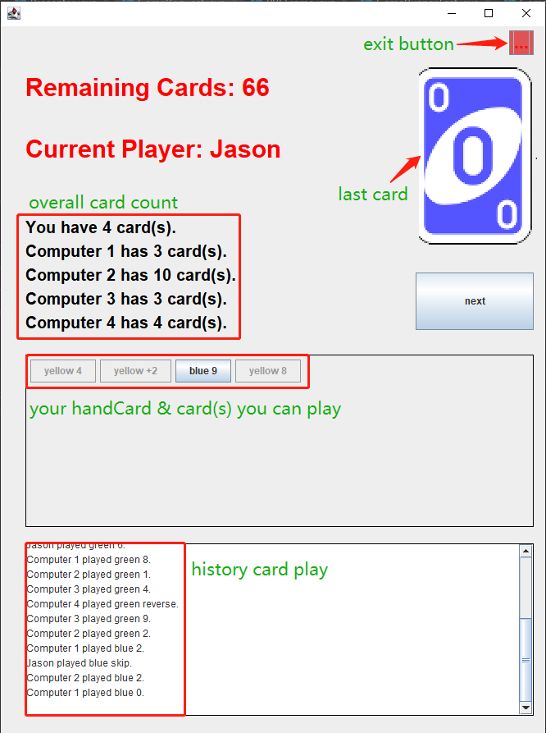
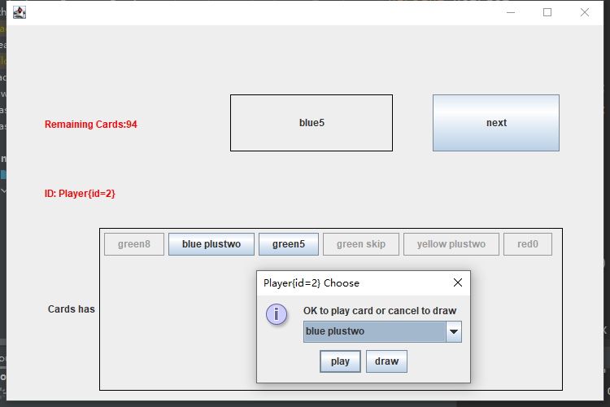
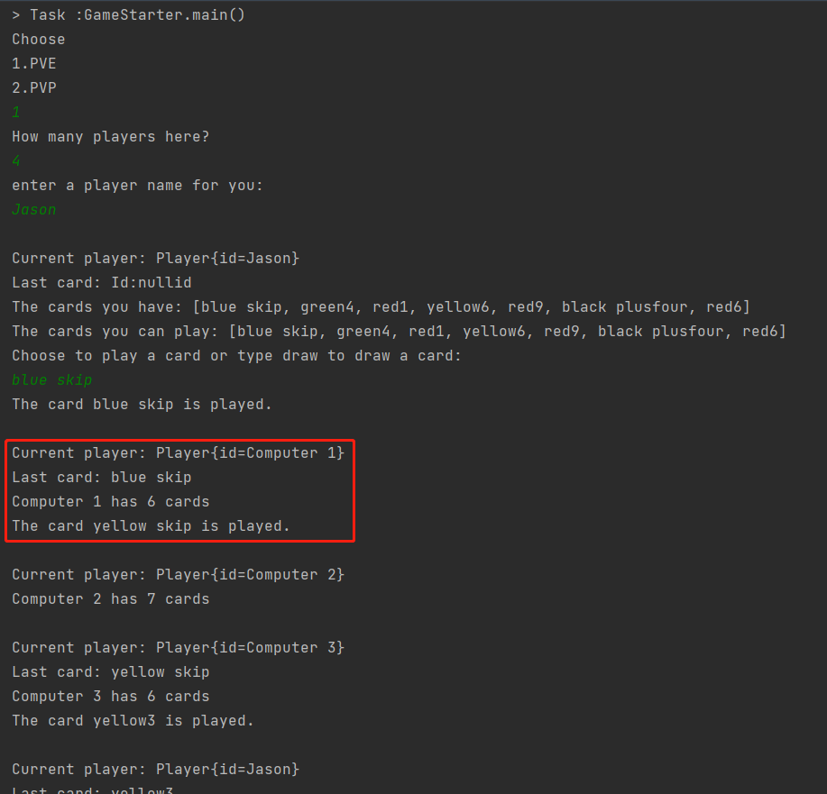
Project Specification
Aspect of Basic Setting
Aspect of design pattern
Aspect of GUI

Slide 5
how your project adheres to Clean Architecture
clearly seperate classes into four layers
follow layer-by-layer rule
dependency inversion pattern

Slide 6
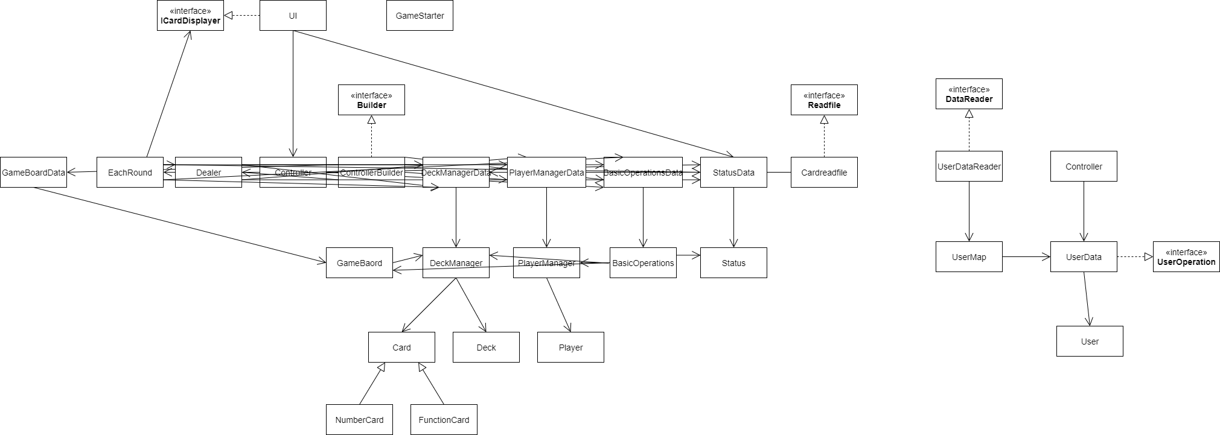
UML (Phase 1)

Slide 7
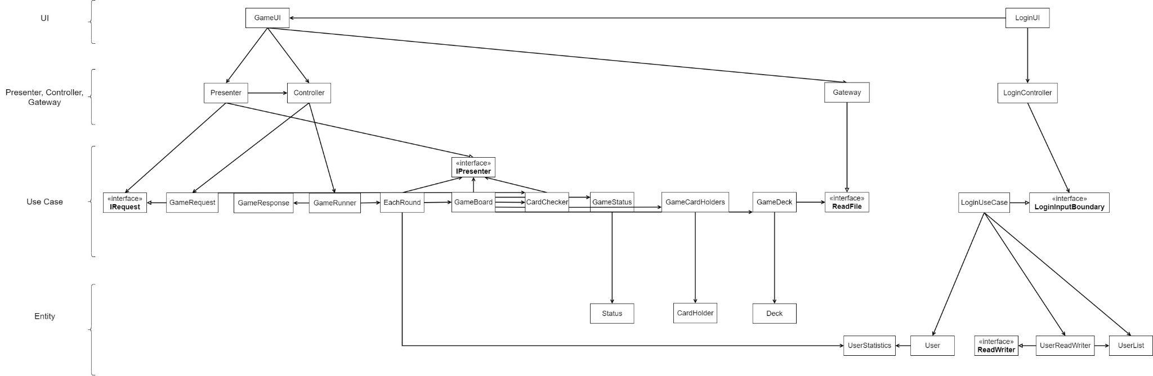
UML (Phase 2)

Slide 8
Major Design Decisions:
Restructure: Use the Presenter, move class from controller to UseCase, Change
the structure of our data(card).
Now log in system stores game data.
Use serializable to construct log in system.
The GUI: Added music and animation, make the game much interesting.
Design Pattern: Iterator, Builder.

Slide 9
how your project is consistent with the SOLID
Intro
OCP
LSP
ISP
DIP
SRP
Con

Slide 10
which packaging strategies you considered
Login --Layers strategy
Uno--Layers strategy

Slide 11
Design Patterns
Implemented:
CardHolder Class - Iterator
PVE/PVP Frame Class - Builder
Change From Phase 1:
Due to Restructure from Command UI to GUI and PVE mode
All Design Pattern in Phase 1 was redesigned
Builder Class build PVP/PVE Frame
Possible implementation in Future:
Memento - Undo Game State
Strategy Pattern - PVE Mode

Slide 12
progress report
what has worked well so far with your design (reflection)
a summary of what each group member has been working on and plans to work on next
Future TODO

